Slide 1


Domain Analysis Modeling
A Requirements Gathering And Documentation Process
Abdul-Malik Shakir
Principal Consultant, Shakir Consulting
Presented to:
The University of Texas M. D. Anderson Cancer Center
Houston, Texas
March 30, 2009
Session 2 of 4

Slide 2
About Me
Abdul-Malik Shakir
Information Management Strategist
City of Hope National Medical Center, Duarte, CA
Since December 2008
Member of Health Level Seven since 1991
  Co-Chair of the HL7 Education Workgroup
  Active member of:
    Architectural Review Board (ArB)
    Public Health and Emergency Response Workgroup (PHER)
    Regulated Clinical Research Information Management Workgroup (RCRIM)
    Modeling and Methodology Workgroup (MnM)
    RIM-Based Application Architecture Workgroup (RIMBAA)
Principal Consultant for Shakir Consulting since 2001
Senior Technical Architecture Advisor for Cal2Cal Corporation assisting the
Los Angeles County Public Health Department since 2005
UML Modeling Facilitator for Clinical Data Interchange Standards Consortium (CDISC) since 2008
BRIDG Model Harmonization Facilitator for International Institute for Safety in Medicine (II4SM) since 2008
March 30, 2009
Domain Analysis Modeling Tutorial
<number> of 86

Slide 3
Two Day Tutorial Agenda
Session 1 Healthcare Informatics Standards & Interoperability | Session 3 Design Level Static Information Models
Session 2 Domain Analysis Modeling | Session 4 RIM-Based Relational Database Design
Monday
Tuesday
March 30, 2009
Domain Analysis Modeling Tutorial
<number> of 86

Slide 4
Presentation Overview
HL7 Development Framework (HDF)
Unified Modeling Language (UML)
Domain Analysis Model Diagrams
  Use Case Diagram
  Activity Diagram
  Class Diagram
Domain Analysis Modeling Controversies
Reference Materials
Check Point Quiz
POIZ Domain Analysis Model
  Use Case Diagram
  Activity Diagram
  Class Diagram
March 30, 2009
Domain Analysis Modeling Tutorial
<number> of 86

Slide 5
HL7
Development Framework
March 30, 2009
Domain Analysis Modeling Tutorial
<number> of 86

Slide 6
Seven Phases of the HDF Methodology
Project initiation
Requirements Documentation
Specification Modeling
Specification Documentation
Specification Approval
Specification Publication
Specification Profiling
March 30, 2009
Domain Analysis Modeling Tutorial
<number> of 86

Slide 7
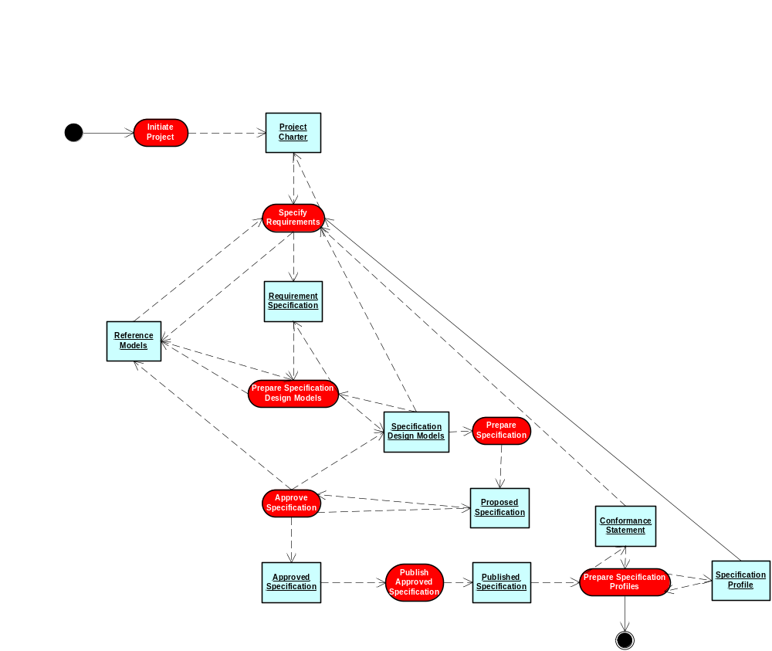
HDF Workflow Diagram
The HDF workflow is not a waterfall methodology.
Each phase builds upon the prior and may cause
prior activities to be revisited and their deliverables
adjusted.
March 30, 2009
Domain Analysis Modeling Tutorial
<number> of 86

Slide 8
Project initiation
During project initiation the project is defined, a project plan is produced, and project approval is obtained. The primary deliverable produced during project initiation is the project charter.
Project
Initiation
Project
Charter
Define project scope, objectives, and intended deliverables
Identify project stakeholders, participants, and required resources
Document project assumptions, constraints, and risk
Prepare preliminary project plan and document inter-project dependencies
Obtain project approval and launch the project
March 30, 2009
Domain Analysis Modeling Tutorial
<number> of 86

Slide 9
Requirements Documentation
During requirements documentation the problem domain is defined, a model of the domain is produced, and the problem domain model is harmonized with HL7 reference models. The primary deliverable produced during requirements documentation is the requirements specification.
Project
Charter
Requirements
Documentation
Requirements Specification
Document Business Process: Dynamic Behavior and Static Structure
Capture Process Flow: UML Activity Diagram
Capture Structure: Domain Information Model and Glossary
Capture Business Rules: Relationships, Triggers, and Constraints
Harmonize the Domain Analysis Model with HL7 Reference Models
March 30, 2009
Domain Analysis Modeling Tutorial
<number> of 86

Slide 10
Specification Modeling
During specification modeling reference models are constrained into design models through a process of iterative refinement driven by requirements specifications and following specification design rules, conventions, and guidelines. The primary deliverable produced during specification modeling is a set of specification design models.
Requirements
Specification
Specification
Modeling
Specification
Design Models
Build design models of static information views
Construct design models of behavioral views
Define reusable design model components
Construct design models of collaboration and interaction
Harmonize design models with HL7 Reference Models
March 30, 2009
Domain Analysis Modeling Tutorial
<number> of 86

Slide 11
Specification Documentation
During specification Documentation the specification design models are packaged into logical units, supplemented with explanatory text, and prepared for approval. The primary deliverable produced during specification documentation is a proposed specification.
Specification
Design Models
Specification
Documentation
Proposed
Specification
Organize design model elements into logical packages
Compose explanatory text, examples, and design rationale
Update design models and requirement specifications
Assemble a proposed specification package
Submit specification for approval
March 30, 2009
Domain Analysis Modeling Tutorial
<number> of 86

Slide 12
Specification Approval
During specification approval the pre-approval specification is subjected to a series of approvals steps. The specific approval steps vary by kind of specification, level of approval, and realm of interest. The primary deliverable produced during specification approval is an approved specification.
Proposed
Specification
Specification
Approval
Approved
Specification
Obtain TSC and Board approval to ballot specification
Form a ballot pool and conduct specification ballot
Assess negative ballots and affirmative comments
Modify specification in response to ballot comments
Resolve negative ballot responses and if necessary re-ballot
March 30, 2009
Domain Analysis Modeling Tutorial
<number> of 86

Slide 13
Specification Publication
During specification publication the approved specification is prepared for prepared for publication and distribution. The primary deliverable produced during specification publication is a published specification.
Approved
Specification
Specification
Publication
Published
Specification
Obtain TSC and Board approval to publish specification
Prepare specification for publication
Submit publication to standards authorities (ANSI/ISO)
Render the specification in various forms of publication media
Post and distribute approved specifications
March 30, 2009
Domain Analysis Modeling Tutorial
<number> of 86

Slide 14
Specification Profiling
During specification profiling specification models are further refined and specifications furthered constrained following the same set of design rules, conventions, and guidelines used in the development of the specification to produce a profile of the specification for use in a particular environment by a defined community of users. The primary deliverable produced during specification profiling is a set of specification profiles and conformance statements.
Published
Specification
Specification
Profiling
Specification
Profiles and Conformance
Statements
Identify community of user for the published specification
Further refine and constrain specification design models
Document exceptions, extensions, and annotations to specifications
Prepare and publish specification profile
Prepare and publish conformance statements
March 30, 2009
Domain Analysis Modeling Tutorial
<number> of 86

Slide 15

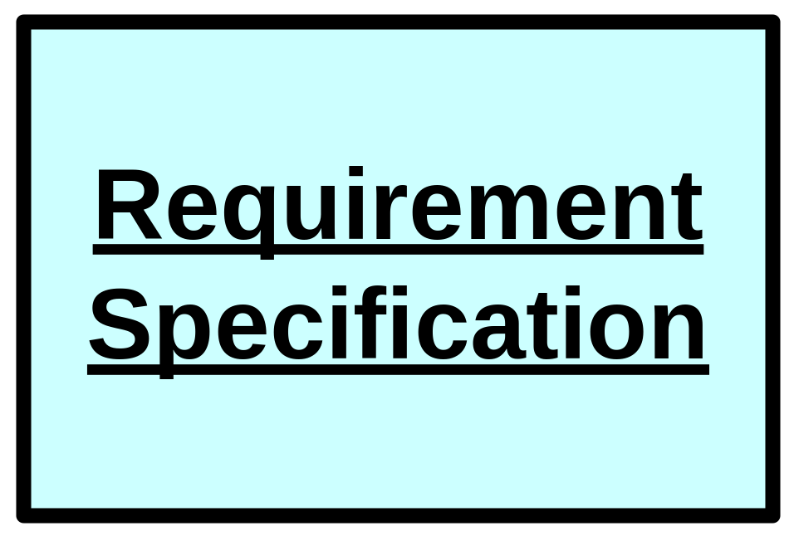
HDF Workflow Diagram
The HDF workflow is not a waterfall methodology.
Each phase builds upon the prior and may cause
prior activities to be revisited and their deliverables
adjusted.
A Domain Analysis Model is a specification of requirements for a project or a domain of interest.
March 30, 2009
Domain Analysis Modeling Tutorial
<number> of 86

Slide 16
Domain Analysis Modeling
PARTY IDENTIFICATION NUMBER
PARTY
PARTY ACTIVITY ROLE
Identification Number
Begin Date
Issuing Authority Name
End Date
Issue Begin Date
Role Code
Issue End Date
PARTY CASE DEFINITION ROLE
CASE DEFINITION
Type Code
Begin Date
Begin Date
End Date
Category Code
Role Code
Description
PATIENT COVERAGE
End Date
Provider Code
PARTY CASE ROLE
Name
Begin Date
End Date
BILLING ACCOUNT
Role Code
PARTY NOTIFICATION
CASE
Begin Date
Begin Date
PARTY TO PARTY ASSOCIATION
End Date
Confirmation Method Code
Notification Receiver Identification Number
Count
Begin Date
Notification Sender Identification Number
Count Type Code
Code
Detection Method Code
End Date
End Date
Identification Number
Transmission Mode Code
Status Code
PUBLIC HEALTH NOTIFICATION
Status Date
Begin Date
End Date
Identification Number
ORGANIZATION
INDIVIDUAL
Entity
Reason Code
Alias Name
Name
Name
Type
Type Code
Outbreak
DIAGNOSIS
Begin Date
Classification Scheme Code
PARTY CONDITION
End Date
Disease Code
Begin Date
Extent Code
Diagnosis Code
Description
Peak Date
Diagnosis Date
End Date
Source Code
Name
INFORMAL ORGANIZATION
Formal Organization
PERSON
NON PERSON LIVING ORGANISM
Source Text
Name Status Text
Industry Code
Birth Date
Genus Name
Status Date
OUTBREAK STATISTIC
Death Date
Species Name
Amount
Ethnicity Code
PARTY LOCATION ROLE
Category Code
Race Code
Begin Date
Type Code
Sex Code
End Date
Soundex Text
Role Code
Occupation Name
Status Code
Status Date
PERSON NAME
PARTY SPECIMEN ROLE
Degree Name
Begin Date
First Name
End Date
Last Name
Role Code
Middle Name
Prefix Name
Suffix Name
Type Code
PARTY VEHICLE ROLE
Begin Date
End Date
Role Code
VEHICLE
HEALTH RELATED ACTIVITY
Description
Begin Date Time
Name
Disposition Date Time
(Implication) Status Code
Disposition Description
Status Date
End Date
Type Code
Identification Number
Notification Indicator
Priority Code
DISEASE ASSOCIATION
Source Type Code
Disease Code
LOCATION
Type Code
Disease Imported Code
Address
Etiologic Status Code
Identification Number
VEHICLE CONDITION
Etiologic Status Date
Name
Exposure Begin Date
Setting Code
Description
Exposure End Date
Type Code
Description Status Code
Infection (or Illness) Type Code(s)
Status Date
SPECIMEN LOCATION
Begin Date
End Date
TEST REFERENCE TABLE
Method Code
Name
Samples Required Number
SPECIMEN
Samples Required Unit Code
DISEASE CAUSING AGENT
Collection Date
Type Code
Agent Type Code
Description
TEST
Agent Name
Identification Number
HEALTH STATUS INQUIRY
REFERRAL
INTERVENTION
Name
Amount
Referral Basis Code
Amount
Source Code
Amount Unit Code
Referral Type Name
Amount Number
Type Code
Begin Date
Referral Acceptance Code
Amount Unit Code
Description
Description
TELEPHONE
ADDRESS
Description Code
Duration
Telephone Type Code
Begin Date
Duration
Duration Unit Code
Area Code
City Name
Duration Unit Code
Enrollment Code
Number
Country Name
End Date
Enrollment Type Code
County Name
Live Births Number
Manufacturer Lot Number
End Date
Manufacturer Lot Number
Manufacturer Name
Postal Code
Manufacturer Name
Name
CODE
Status Date
TEST RESULT
Reason Text
Route Code
Code
State Code
Amount
Result Date
Status Code
Description
Street Address Text
Amount Unit Code
Result Text
Status Date
Coding System Name
Type Code
Code
Status Code
Date
Status Date
Description
Travel Country Name
Description Code
Type Code
March 30, 2009
Domain Analysis Modeling Tutorial
<number> of 86

Slide 17

What is a Domain Analysis Model
A domain analysis model is documentation of stakeholders, activities, interactions, and information for a particular domain of interest.
A domain analysis model provides context for development of HL7 specifications by documenting specification requirements from a variety of subject matter expert perspectives.
HL7 specification designs are intended to fulfill the behavioral, interaction and informational requirements documented in domain
analysis models.
March 30, 2009
Domain Analysis Modeling Tutorial
<number> of 86

Slide 18

Why Model
To aid in understanding relevant functions and information of a particular domain
To communicate the modeler’s understanding of the domain and allow that understanding to be assessed by others
To aid in reconciling multiple perspectives of a domain by combining varying perspectives into a single specification
To document a solution design (existing or planned) so that the design may be evaluated
March 30, 2009
Domain Analysis Modeling Tutorial
<number> of 86

Slide 19
Reveal Assumptions
Do you
play
football?
Yes, I do
play
football.
Revealing assumptions is an essential component of effective communication.
Data models are an effective means of documenting our assumptions
about a domain
March 30, 2009
Domain Analysis Modeling Tutorial
<number> of 86

Slide 20
Reduce Ambiguity
A
0..*
B
1
0..*
0..*
C
Modeling provides a language that allows us to unambiguously express our understanding and assumptions about the actions and information of interest in a particular domain
March 30, 2009
Domain Analysis Modeling Tutorial
<number> of 86

Slide 21
Reconcile Conflicts
A
B
X
B
0..*
1
0..*
1
0..*
0..*
0..*
0..*
C
C
Sharing models provides
an opportunity to identify and reconcile conflicts in our understanding
and to validate our assumptions.
March 30, 2009
Domain Analysis Modeling Tutorial
<number> of 86

Slide 22
Expand Understanding
A
0..*
B
A
B
1
0..*
0..*
0..*
1
0..*
0..*
C
D
Sharing models also provides
an opportunity to identify gaps in our understanding.
No one of individual has the complete view of domain of interest.
March 30, 2009
Domain Analysis Modeling Tutorial
<number> of 86

Slide 23

Consolidate Ideas
E
G
B
0..*
1
0..*
1
0..*
1
C
X
A
0..*
0..1
F
1
0..*
D
A
0..*
B
X
B
A
B
1
0..*
1
0..*
0..*
0..*
0..*
1
0..*
0..*
0..*
C
C
D
Model I
Model II
Model III
March 30, 2009
Domain Analysis Modeling Tutorial
<number> of 86

Slide 24

Value of Modeling
Reveal Assumptions
Reduce Ambiguity
Reconcile Conflicts
Expand Understanding
Consolidate Ideas
March 30, 2009
Domain Analysis Modeling Tutorial
<number> of 86

Slide 25
Unified Modeling Language
The HDF does not prescribe a particular modeling notation or methodology.
The preferred modeling notation is the Unified Modeling Language (UML).
UML is a modeling notation not a methodology.
UML is used with multiple development methodologies such as Agile Processes and Rational Unified Process (RUP).
The HDF is methodology neutral, as is the recommended UML notation.
March 30, 2009
Domain Analysis Modeling Tutorial
<number> of 86

Slide 26
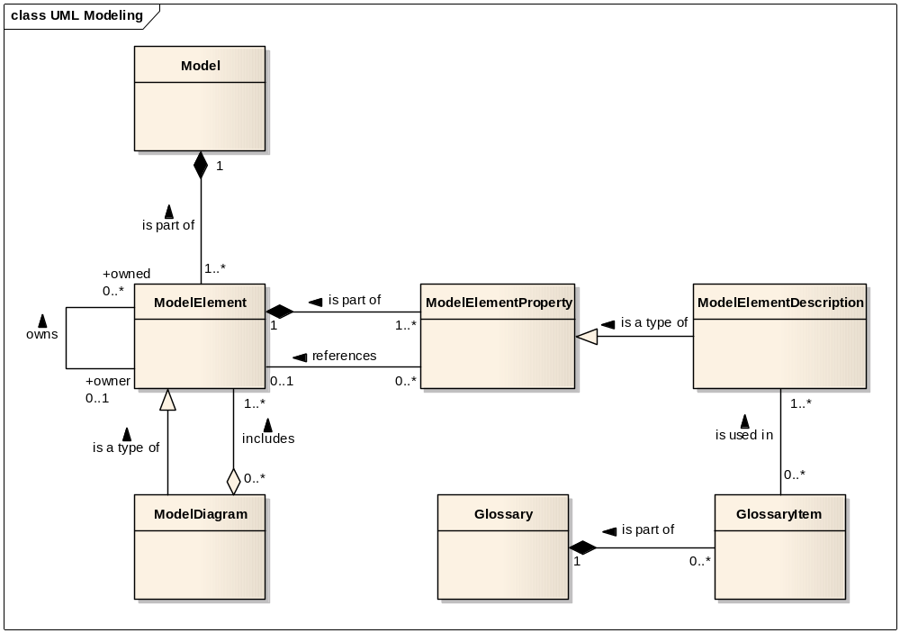
Introduction to UML Modeling
March 30, 2009
Domain Analysis Modeling Tutorial
<number> of 86

Slide 27
Introduction to UML Modeling
A Model always is composed of one or more Model Element
A Model Element always is part of one Model
A Model Element always is composed of one or more Model Element Property
A Model Element Property always is part of one Model Element
A Model Element Property sometimes references one Model Element
A Model Element sometimes is referenced by one or more Model Element Property
A Model Element Description always is a type of one Model Element Property
A Glossary sometimes is composed of one or more Glossary Item
A Glossary Item always is part of one Glossary
A Glossary Item always is used in one or more Model Element Description
A Model Element Description sometimes uses one or more Glossary Item
A Model Element sometimes owns one or more Model Element
A Model Element sometimes is owned by one Model Element
A Model Diagram always is a type of one Model Element
A Model Diagram always includes one or more Model Element
A Model Element sometimes is included in one or more Model Diagram
March 30, 2009
Domain Analysis Modeling Tutorial
<number> of 86

Slide 28
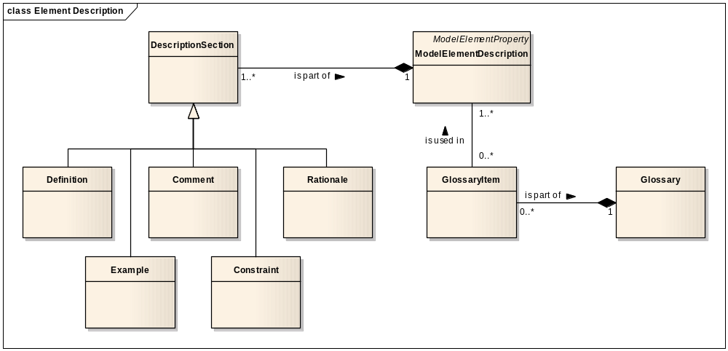
Model Element Description
Model element descriptions have sections. There is a mandatory definition section followed by optional example, comment, constraint, and rationale sections.
A subset of the terms used in a model element description may need to be defined as a glossary item.
March 30, 2009
Domain Analysis Modeling Tutorial
<number> of 86

Slide 29
Example Model Element Description
Person.birthDate
  Definition: the calendar date corresponding to when the person was born.
  Examples: 06/11/1954; 1976; 12/1957
  Comment: birthdate may be a partial date when only the calendar year or calendar month and year are known.
  Constraints: birthdate shall not exceed current date. birthdate must be less than or equal to person.deceaseDate
  Rationale: birth date is needed to approximate a person’s age for use in clinical decision making
March 30, 2009
Domain Analysis Modeling Tutorial
<number> of 86

Slide 30
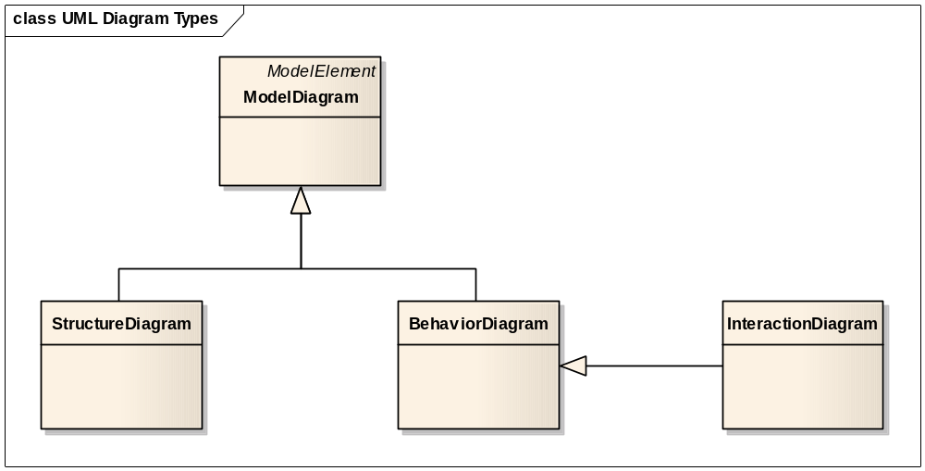
UML Diagram Classifications
There are three classifications of UML diagrams:
  Structure diagrams. A type of diagram that depicts the elements of a specification that are irrespective of time.
  Behavior diagrams. A type of diagram that depicts behavioral features of a system or business process.
  Interaction diagrams. A subset of behavior diagrams which emphasize object interactions.
March 30, 2009
Domain Analysis Modeling Tutorial
<number> of 86

Slide 31
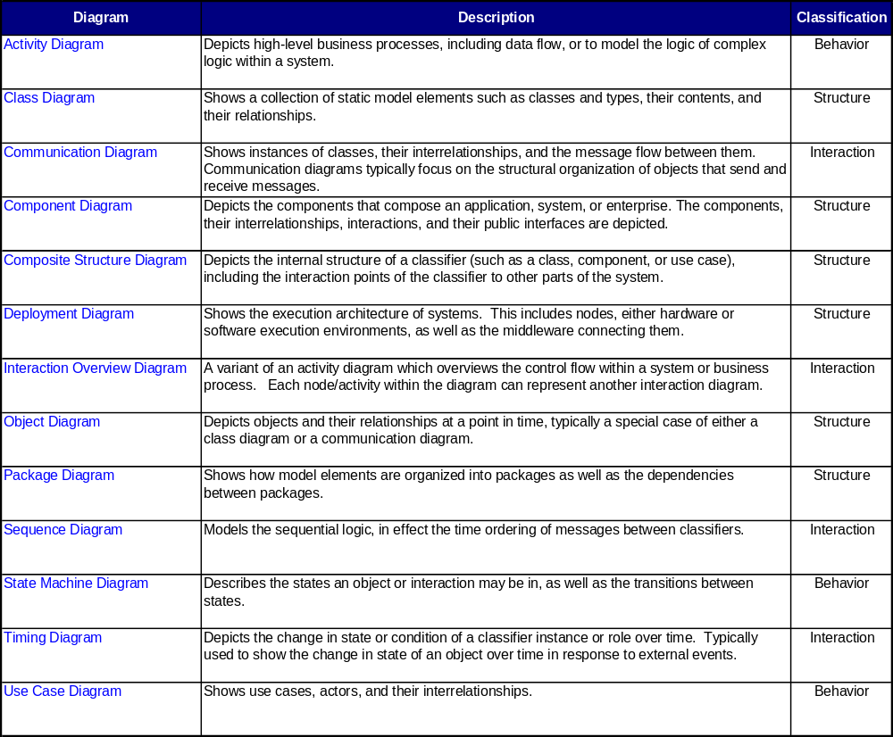
UML Diagram Types
March 30, 2009
Domain Analysis Modeling Tutorial
<number> of 86

Slide 32
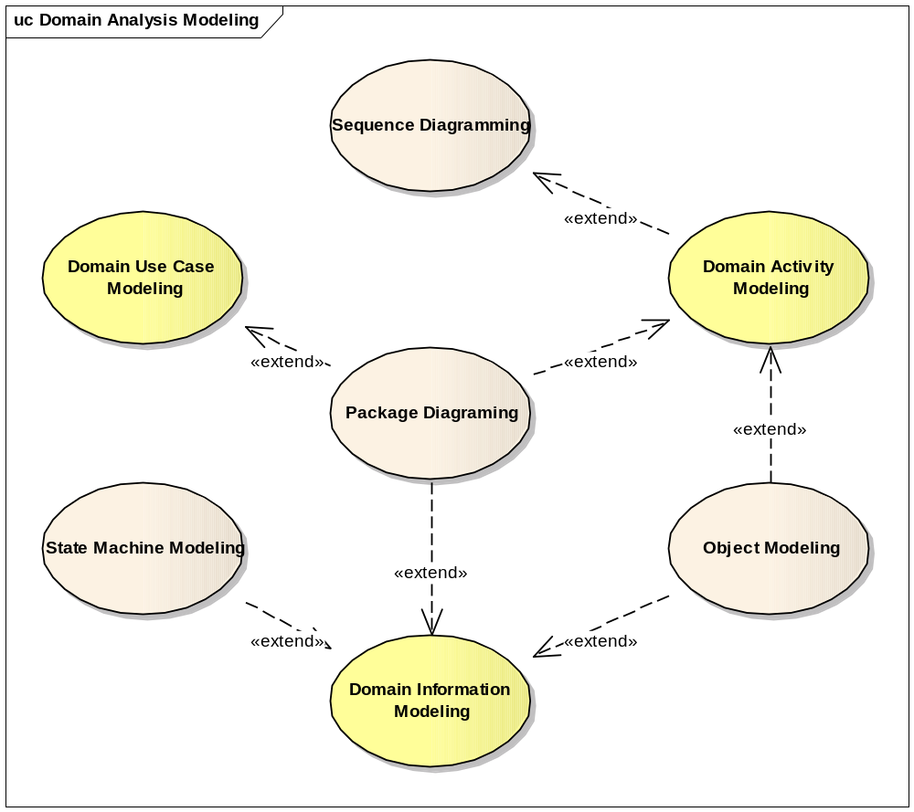
Domain Analysis Modeling
March 30, 2009
Domain Analysis Modeling Tutorial
<number> of 86

Slide 33
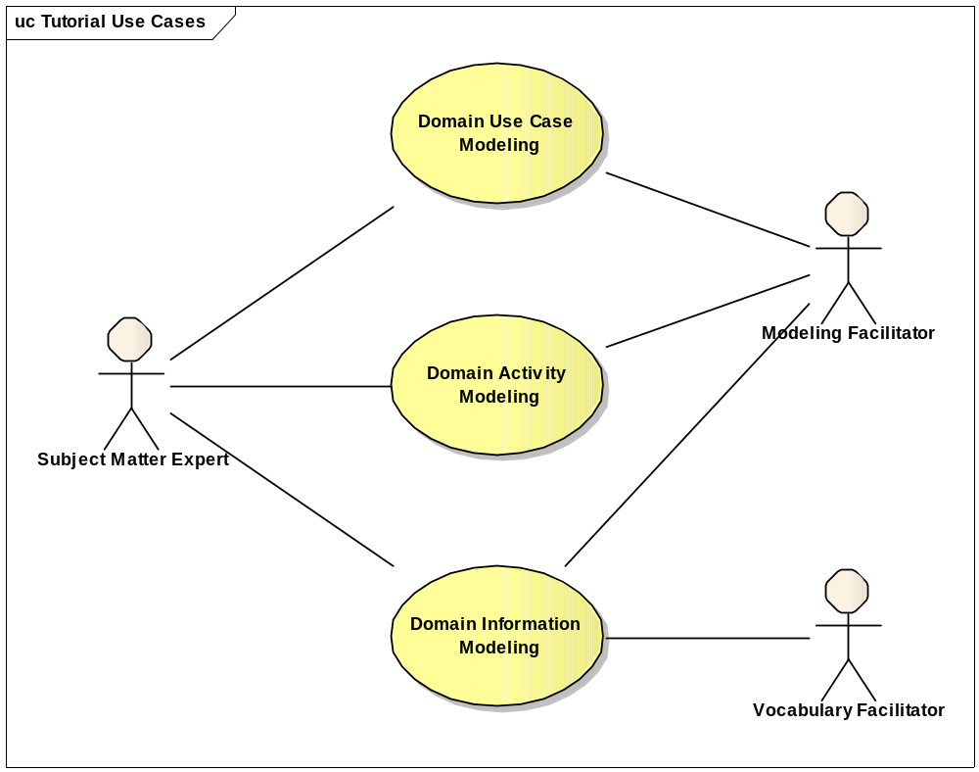
Tutorial Domain Analysis Use Cases
March 30, 2009
Domain Analysis Modeling Tutorial
<number> of 86

Slide 34
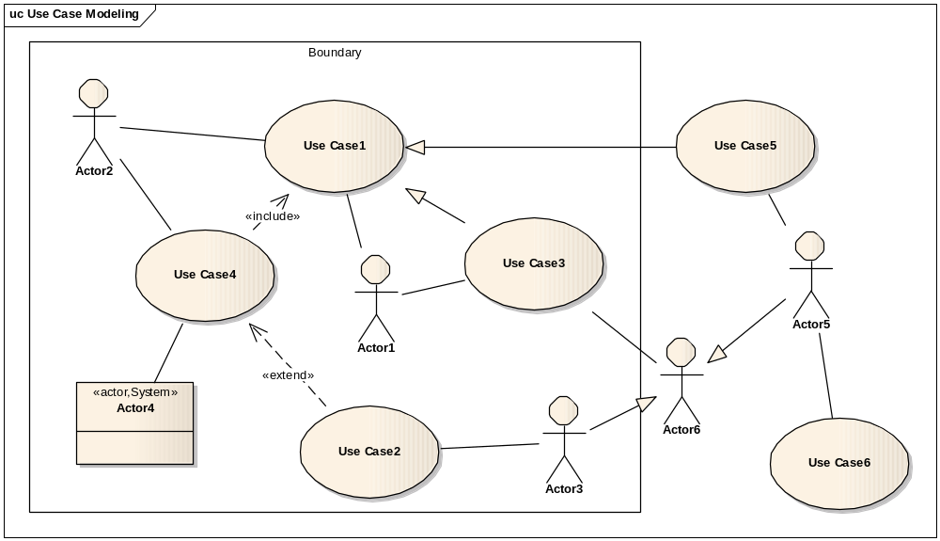
Use Case Diagram
March 30, 2009
Domain Analysis Modeling Tutorial
<number> of 86

Slide 35
Use Case Diagram
A use case diagram is used to define the scope of activities and stakeholders of interest to the domain analysis model.
Each use case is an activity in the domain of interest that provides value to the participating actors
Use case actors are persons, organizations, systems, and system components that participate in use cases as performers or beneficiaries
March 30, 2009
Domain Analysis Modeling Tutorial
<number> of 86

Slide 36
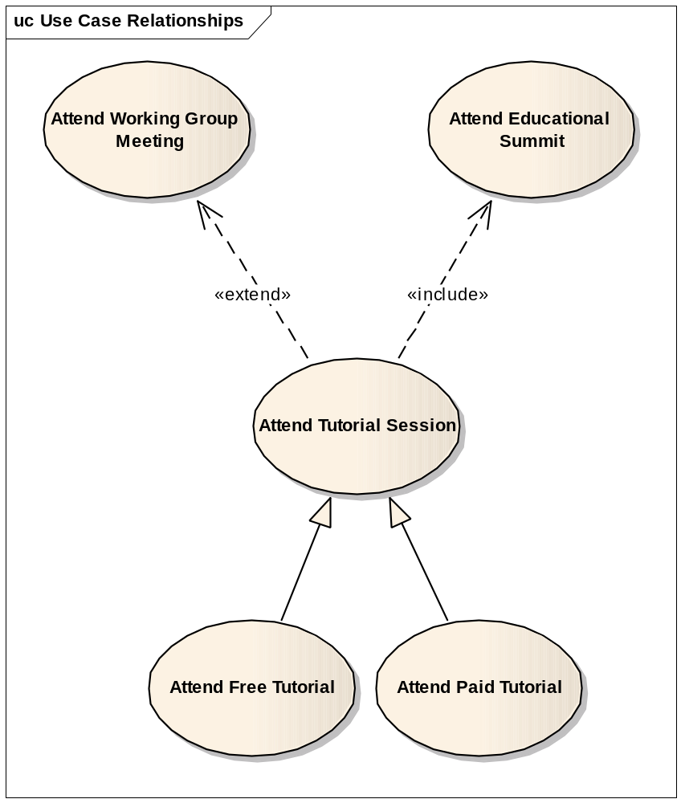
Use Case Relationships
Extend – relates a use case that contains an set of optional activities from the parent use case.
Include – relates a use case that contains a subset of activities from the parent use case.
Generalization – relates a use case that is a specialization of a generic parent use case.
March 30, 2009
Domain Analysis Modeling Tutorial
<number> of 86

Slide 37
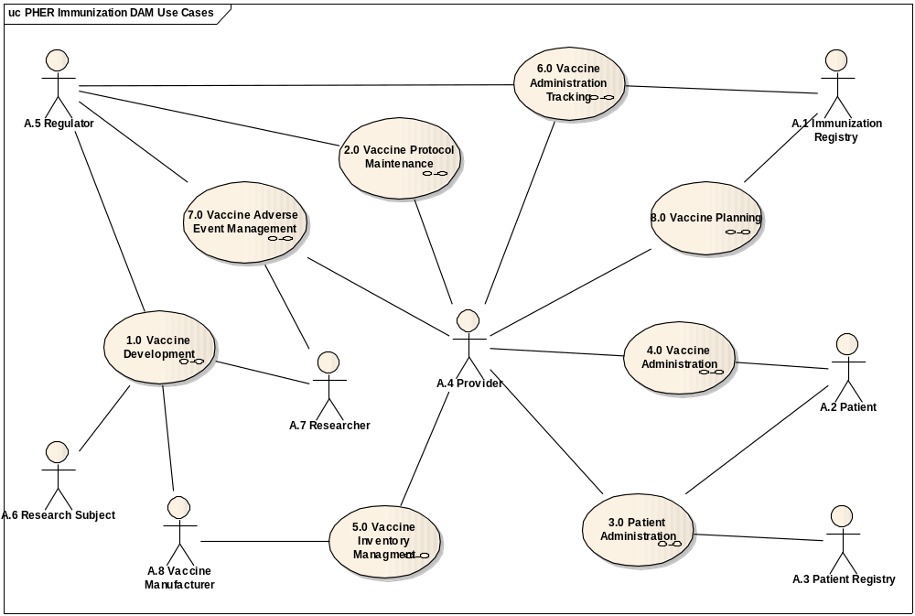
POIZ DAM v0r2 – Use case diagram
March 30, 2009
Domain Analysis Modeling Tutorial
<number> of 86

Slide 38
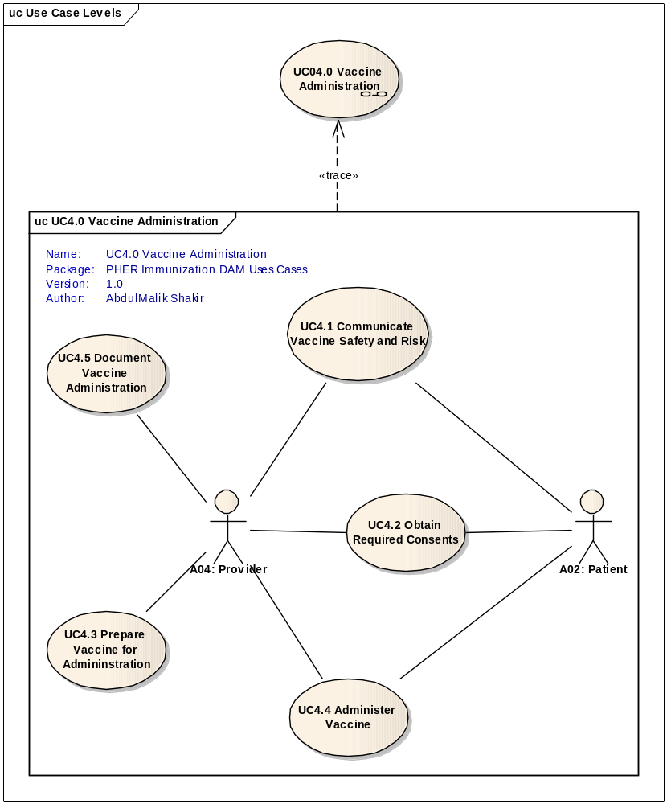
Use Case Leveling
Use case leveling can be used to minimize complexity in a large use case diagram
Lower level use cases are fully encapsulated by a higher level use case
Leaf level use cases are always of the form an active verb followed by a noun
Higher level use case are typically of the form a noun followed by a gerund style verb (-ment, -ing, -tion).
Use case leveling is sometimes used to separate business level use cases from system level use cases.
March 30, 2009
Domain Analysis Modeling Tutorial
<number> of 86

Slide 39
Tutorial Domain Analysis Use Cases
March 30, 2009
Domain Analysis Modeling Tutorial
<number> of 86

Slide 40
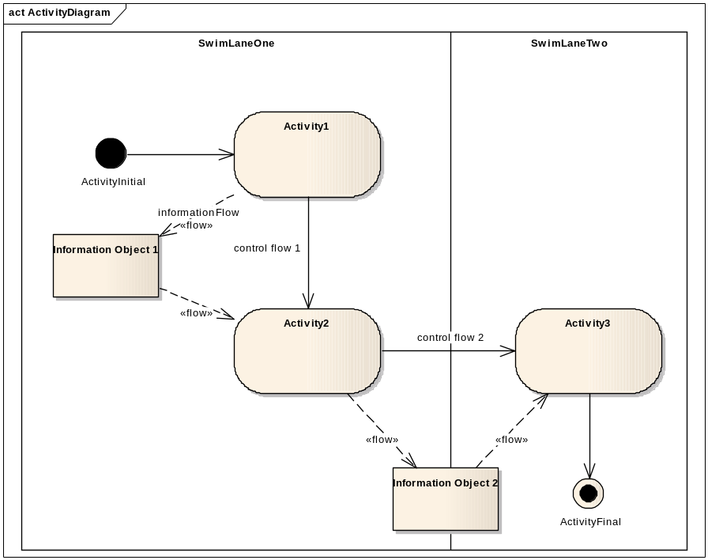
Activity Diagram
Activity diagrams depict a controlled sequence of activities.
Activity diagrams optionally include swim lanes and information flows.
Swim lanes can be used to related processes to responsible actors.
Information flows are useful for linking behavioral requirements to information requirements.
March 30, 2009
Domain Analysis Modeling Tutorial
<number> of 86

Slide 41
Activity Diagram
Activity diagrams are typically used to depict the flow of activities within a given use case.
Swim lanes in an activity diagram are often traceable to the actors involved in the use case realized by the activity diagram.
Information objects in an activity model can be linked to classes in a class model.
Information flows, especially those that cross swim lanes, are often the subject of HL7 specifications
March 30, 2009
Domain Analysis Modeling Tutorial
<number> of 86

Slide 42
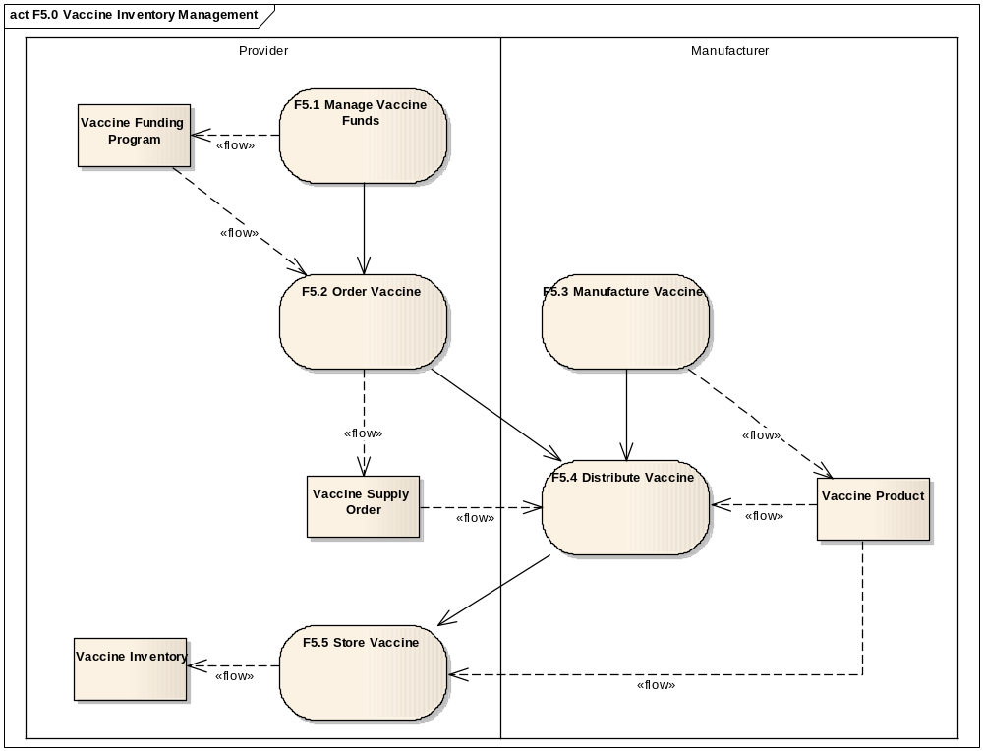
Sample Activity Diagram
March 30, 2009
Domain Analysis Modeling Tutorial
<number> of 86

Slide 43
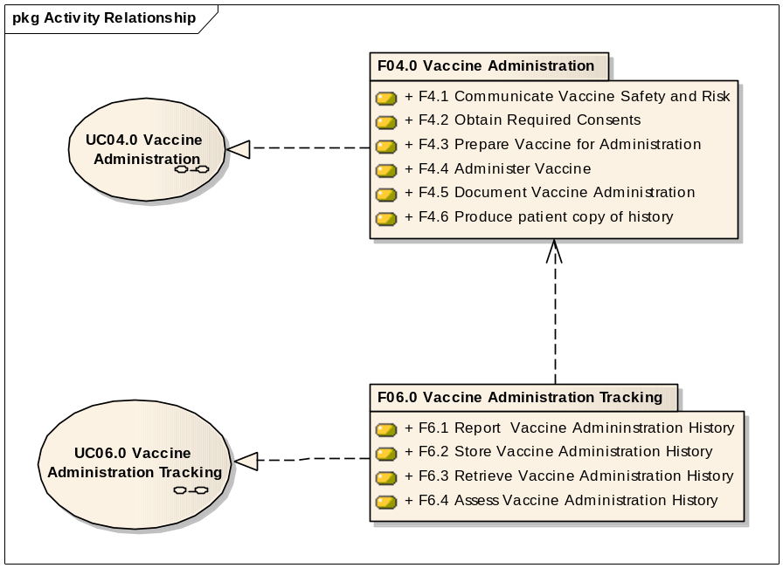
Activity Dependencies and Use Case Realizations
Activities depicted in activity diagrams realize a use case
A package of activities may have a dependency to another package of activities.
March 30, 2009
Domain Analysis Modeling Tutorial
<number> of 86

Slide 44
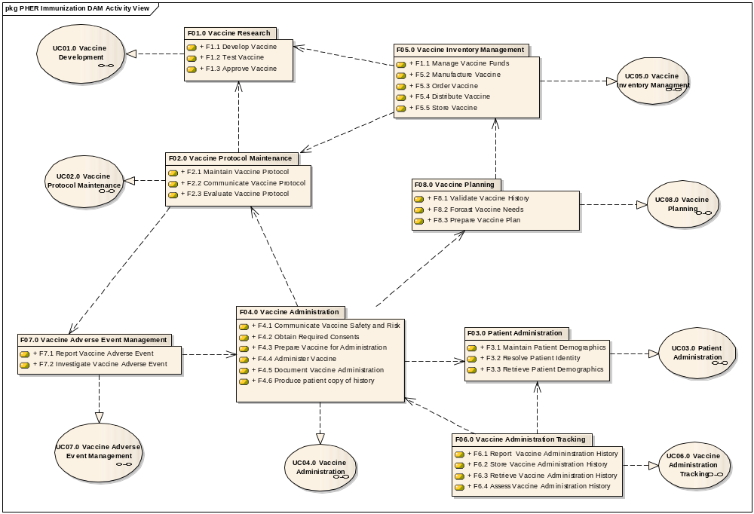
POIZ DAM v0r3 – Activity diagram
March 30, 2009
Domain Analysis Modeling Tutorial
<number> of 86

Slide 45
Tutorial Domain Analysis Use Cases
March 30, 2009
Domain Analysis Modeling Tutorial
<number> of 86

Slide 46
Information Model Class Diagram
Class: something about which data
is collected
Relationship: an association between classes
Attribute: information about a class
Datatype: attribute characteristic
Class
Attribute : Datatype
Attribute : Datatype
Attribute : Datatype
1
Relationship
0..*
Class
Attribute : Datatype
Attribute : Datatype
Attribute : Datatype
March 30, 2009
Domain Analysis Modeling Tutorial
<number> of 86

Slide 47
Sample Class Diagram Components
Class: Person,
Person Phone
Relationship: Person <has Person Phone,
Person Phone <belongs to
Person
Attribute: name, birth date, gender code
area code, number, extension
Datatypes: PN, TS, CD, ST
Person
name : PN
birth date : TS
gender code : CD
1
belongs to
has
0..*
Person Phone
area code : ST
number : ST
extension : ST
March 30, 2009
Domain Analysis Modeling Tutorial
<number> of 86

Slide 48
Domain Information Modeling
Identify major classes
Determine relationships among classes
Add class attributes
Assign attribute datatypes
Enumerate coded attribute values
March 30, 2009
Domain Analysis Modeling Tutorial
<number> of 86

Slide 49

Identify Major Classes
A class is something about which data is collected. It can be a person, place, thing, or abstract concept.
A class is really a classification of objects. An object is an instance of a class.
For example, Jane, John, Joe, and Mary are objects that might be classified into the class Person.
It is the job of the modeler to apply a classification scheme that adequately disambiguates the plethora of business objects in an enterprise or domain of interest.
There are multiple valid ways to classify objects. Some useful, some not so useful.
“All models are wrong, some are useful” --- George Box
March 30, 2009
Domain Analysis Modeling Tutorial
<number> of 86

Slide 50
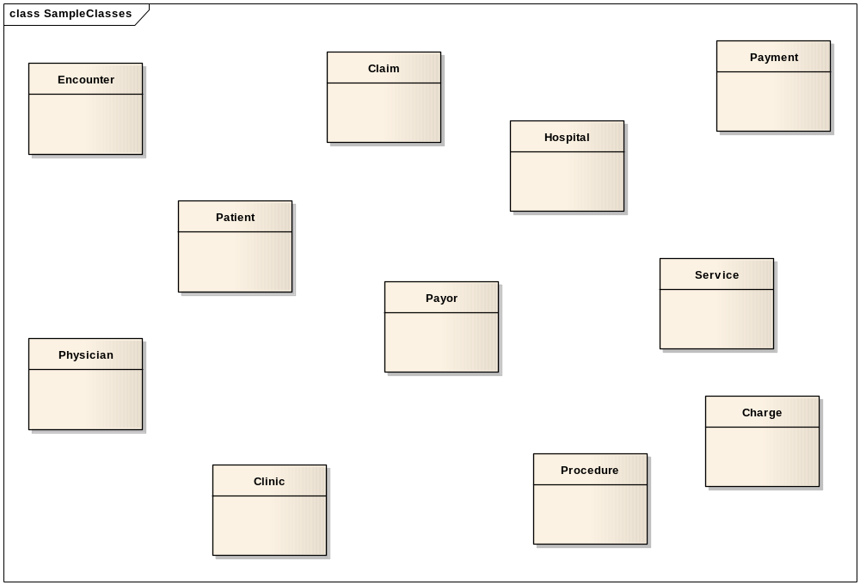
Sample Healthcare Finance Domain Classes
March 30, 2009
Domain Analysis Modeling Tutorial
<number> of 86

Slide 51
Domain Information Model Classes
Have subject matter experts describe an activity or information need.
Listen for major objects of interest that you can reflect in the model as major groupings of information items.
Be prepared to adjust this initial list as you proceed with subsequent modeling steps.
Use class names that are familiar to the subject matter expert.
Use singular nouns as class names and document the class in a data dictionary.
March 30, 2009
Domain Analysis Modeling Tutorial
<number> of 86

Slide 52
Domain Information Modeling
Identify major classes
Determine relationships among classes
Add class attributes
Assign attribute datatypes
Enumerate coded attribute values
March 30, 2009
Domain Analysis Modeling Tutorial
<number> of 86

Slide 53
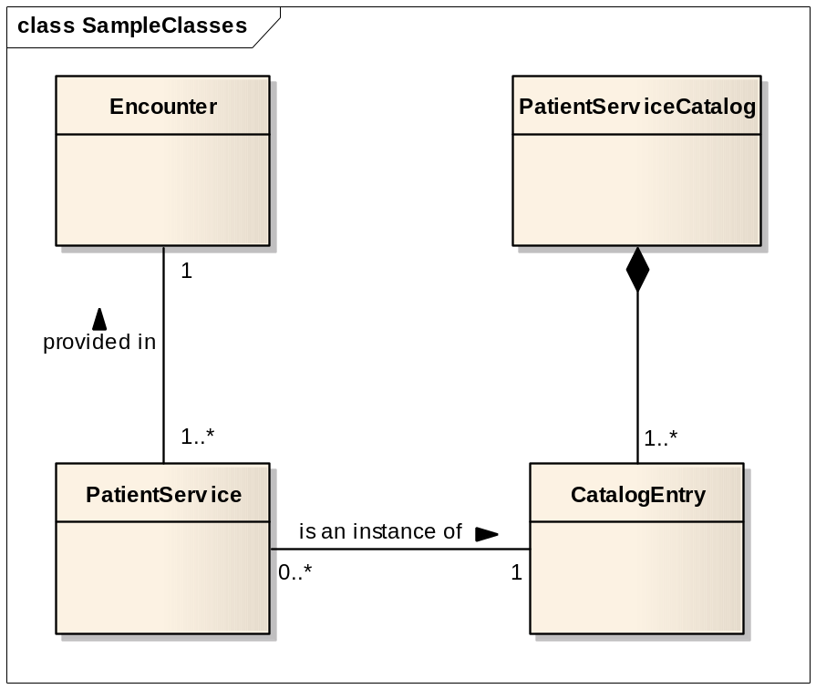
Determine Relationships Among Classes
A Relationship is an association between one class and another, or between a class and another instance of the same class.
Relationships can be difficult to uncover. You need to listen carefully to the subject matter expert.
Listen for verb or prepositional phases used to describe classes.
Assign relationship names that are relatively short, meaningful, and intuitive to subject matter experts.
Relationship names are typically verb or prepositional phrases expressed in the present tense.
The Patient Services [provided in] an
Encounter must [have a corresponding
Entry] in the Patient Service Catalog.
March 30, 2009
Domain Analysis Modeling Tutorial
<number> of 86

Slide 54
Class Relationship Types
Mother
Parent
1
Generalization
Association
1..*
Child
Mother
Father
Team
Building
Aggregation
1..*
1
Composition
0..*
1..*
TeamMember
BuildingFloor
March 30, 2009
Domain Analysis Modeling Tutorial
<number> of 86

Slide 55
Multiplicity Values
Multiplicity Meaning
  1 Only one (same as 1..1)
  0..1 Zero or one
  0..* Zero or more
  1..* One or more
  0..n Zero to n (where n > 1)
  1..n One to n (where n > 1)
  n..m Where n and m both > 1
  n..* N or more
March 30, 2009
Domain Analysis Modeling Tutorial
<number> of 86

Slide 56
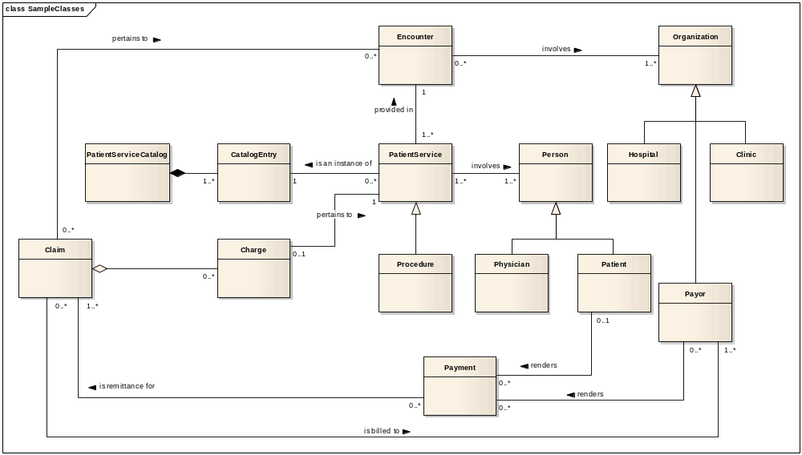
Sample Class Diagram With Relationships
March 30, 2009
Domain Analysis Modeling Tutorial
<number> of 86

Slide 57
Relationships Impact the List of Classes
Adding relationships will sometimes cause you to adjust the list of classes.
Class data dictionary entries will also lead to changes in the list of classes.
Relationships names are directed verb phrases between participating classes
Relationships may be named in either or both directions.
Relationships should be documented as a list of assertions that can be validated by subject matter experts.
March 30, 2009
Domain Analysis Modeling Tutorial
<number> of 86

Slide 58
Relationship Assertion
A relationship assertion is a sentence derived from the data model by
examining the relationship between two classes. The sentence asserts
a fact implied by the relationship. A subject matter expert must be
consulted to determine if the assertion is true. If the assertions is not
true then the model must be modified.
A(n) Class {always / sometimes } relationship name {one / one or more} Class
A Patient Service always is provided in one Encounter
March 30, 2009
Domain Analysis Modeling Tutorial
<number> of 86

Slide 59
Sample DIM Relationship Assertions
An Organization sometimes is involved in one or more Encounter
An Encounter always involves one or more Organization.
A Hospital always is a type of one Organization
A Clinic always is a type of one Organization
A Payor always is a type of one Organization
An Encounter always provides one or more Patient Service
A Patient Service always is provided in one Encounter
A Patient Service always is an instance of one Catalog Entry
A Catalog Entry always is part of one Patient Service Catalog
A Patient Service Catalog always has as part one or more Catalog Entry
A Procedure always is a type of one Patient Service
A Patient Service always involves one or more Persons
A Person always is involved in one or more Patient Service
A Physician always is a type of one Person
A Patient always is a type of one Person
A Patient Service sometimes has one Charge
A Charge always pertains to one Patient Service
A Charge always is aggregated by one Claim
A Claim sometimes aggregates one or more Charges
A Claim sometimes pertains to one or more Encounter
An Encounter sometimes is pertinent to one or more Claim
A Claim sometimes is remitted by one or more Payment
A Payment always is remittance for one or more Claim
A Payment sometimes is rendered by one Patient
A Patient sometimes renders one or more Payment
A Payment sometimes is rendered by one or more Payor
A Payor sometime renders one or more Payment
A Claim always is billed to one or more Payor
A Payor sometimes is billed one or more Claim
March 30, 2009
Domain Analysis Modeling Tutorial
<number> of 86

Slide 60






Review DIM Relationship Assertions
Expect a wide range of reactions from the SMEs as they consider the relationship assertions.
Resist the temptation to remodel as the assertions are being reviewed.
Capture significant business rules as comments on the relationships.
Pay particular attention to the subtype / super type structures.
Replace many-to-many relationships with associative classes.
When the review is complete, record the findings and then update the data model.
Reissue the relationship assertions for review
Repeat until done.
Relationship
Assertions
March 30, 2009
Domain Analysis Modeling Tutorial
<number> of 86

Slide 61
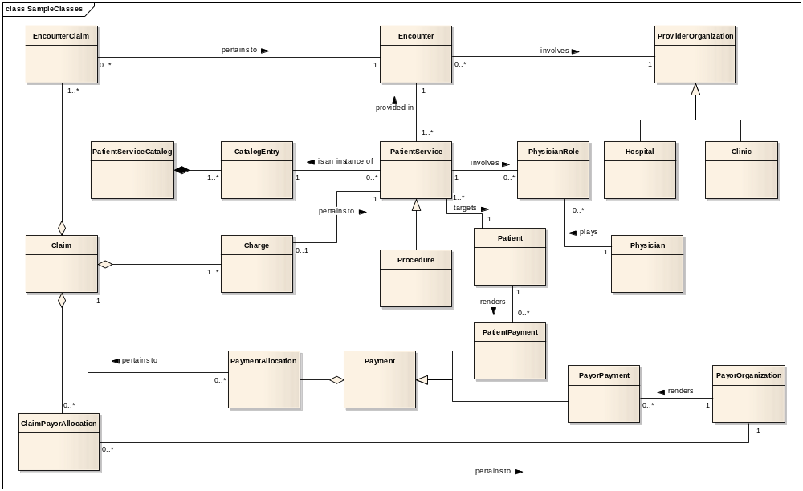
Updated Class Relationship Diagram
March 30, 2009
Domain Analysis Modeling Tutorial
<number> of 86

Slide 62
Domain Information Modeling
Identify major classes
Determine relationships among classes
Add class attributes
Assign attribute datatypes
Enumerate coded attribute values
March 30, 2009
Domain Analysis Modeling Tutorial
<number> of 86

Slide 63
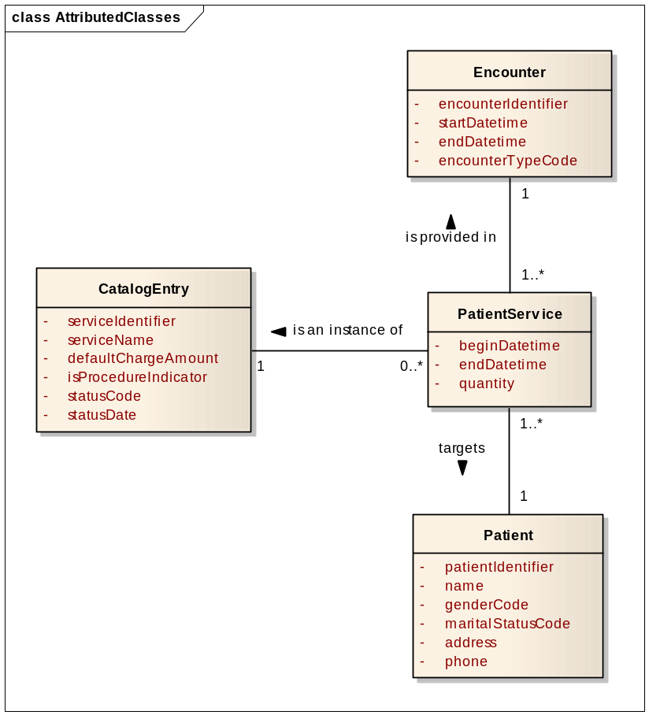
Add Class Attributes
Attributes describe the information capable of being captured about a class.
The attribute name should clearly inform the SMEs what information the attribute contains.
The attribute name should follow a standard naming convention
Attribute definitions must be documented in the data dictionary.
Alias attribute names should be included in the attribute data dictionary documentation.
Attribute integrity rules should be documented in the data dictionary.
Attributes must be placed in the most appropriate class (i.e., it must be a piece of information about the class it is placed in).
March 30, 2009
Domain Analysis Modeling Tutorial
<number> of 86

Slide 64
Attribute Naming Convention
Attributes should be named as singular nouns in the form:
[Class Name]-{Qualifier Name}-Attribute Type Name
Where:
  Class Name is the name of the class the attribute is located in.
  Class name may be omitted but remains an assumed part of the
  Attribute name for the purpose of determining uniqueness.
  Qualifier Word is a word used to convey the business meaning of the attribute and to disambiguate the attribute from others of the same type in the class.
  Attribute Type Name indicates the classification of the attribute as specified in a previously specified, well documented, collection of attribute type names.
March 30, 2009
Domain Analysis Modeling Tutorial
<number> of 86

Slide 65
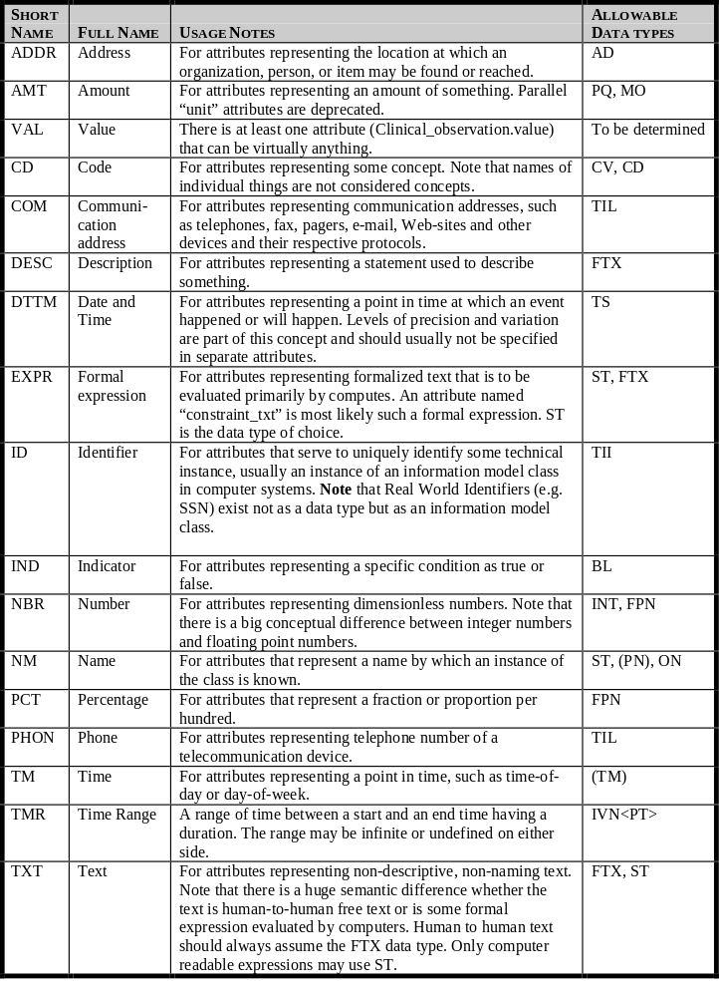
Sample Attribute Type Names
The sample table of attribute type names was extracted from the HL7 Message Development Framework document.
It can be used as a good starting place for determining attribute type names for you own modeling efforts.
March 30, 2009
Domain Analysis Modeling Tutorial
<number> of 86

Slide 66
Class Modeling Process
Identify major classes
Determine relationships among classes
Add class attributes
Assign attribute datatypes
Enumerate coded attribute values
March 30, 2009
Domain Analysis Modeling Tutorial
<number> of 86

Slide 67
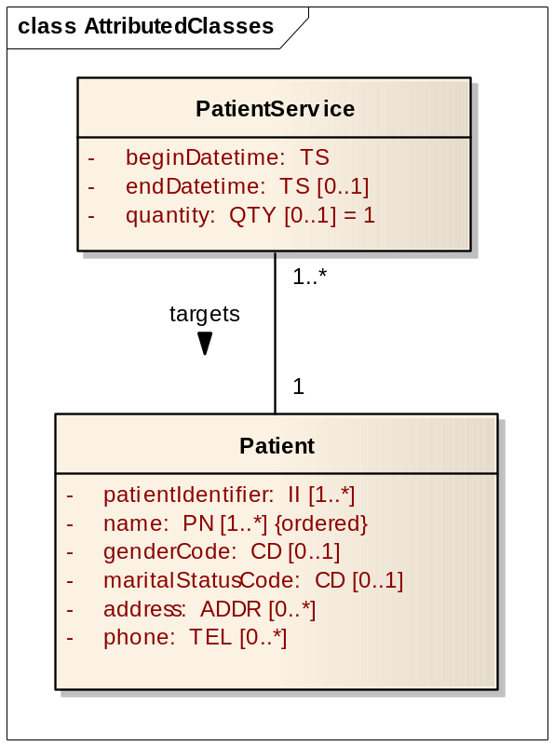
Assign Attribute Datatypes
Attribute datatypes provide syntactical definition to class attributes.
An attributes’ datatype determines the characteristics of the data that may be assigned to the attribute.
Attribute datatypes may be simple or complex.
Complex datatype should be modeled in a separate class diagram and referenced in the domain information model.
March 30, 2009
Domain Analysis Modeling Tutorial
<number> of 86

Slide 68
Assign Attribute Datatypes
Syntactic definition specified by attribute datatypes include:
  Structural features
  Multiplicity
  Collection type
  Collection ordering
  Default value
March 30, 2009
Domain Analysis Modeling Tutorial
<number> of 86

Slide 69
Class Modeling Process
Identify major classes
Determine relationships among classes
Add class attributes
Assign attribute datatypes
Enumerate coded attribute values
March 30, 2009
Domain Analysis Modeling Tutorial
<number> of 86

Slide 70
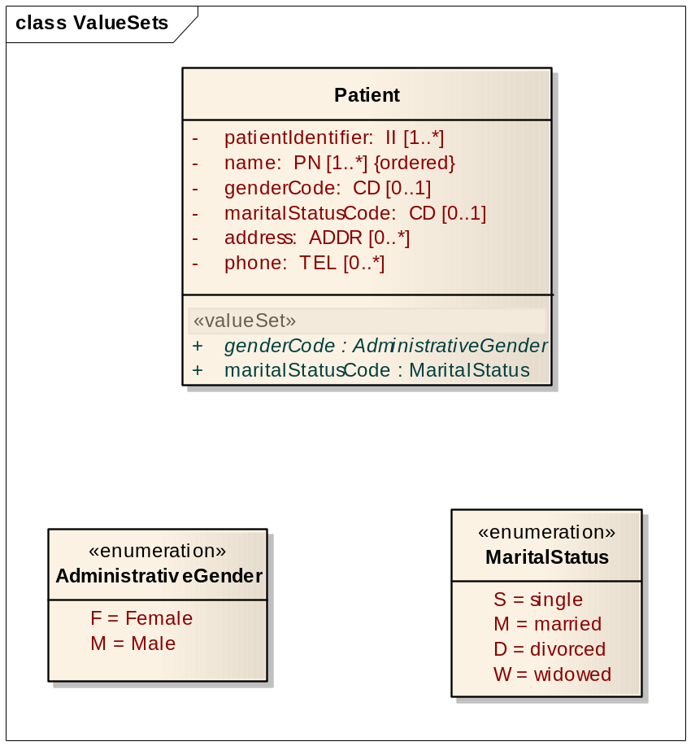
Coded Attribute Values
Bind coded attributes to an enumerated list of values or a reference to a list of values
Model enumerations in a separate class diagram
March 30, 2009
Domain Analysis Modeling Tutorial
<number> of 86

Slide 71
Class Modeling Process
Identify major classes
Determine relationships among classes
Add class attributes
Assign attribute datatypes
Enumerate coded attribute values
March 30, 2009
Domain Analysis Modeling Tutorial
<number> of 86

Slide 72
Tutorial Domain Analysis Use Cases
March 30, 2009
Domain Analysis Modeling Tutorial
<number> of 86

Slide 73
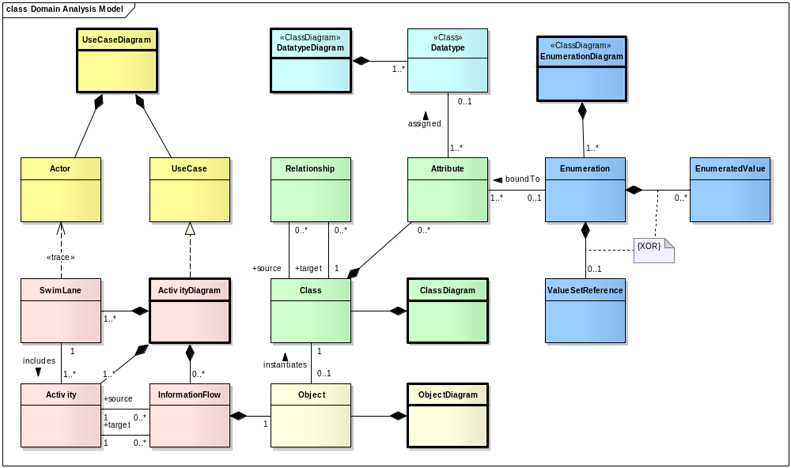
Domain Analysis Modeling
March 30, 2009
Domain Analysis Modeling Tutorial
<number> of 86

Slide 74

Domain Analysis Controversies
UML Notation
Tooling
RIM traceability
Balloting
Scope Project / Committee
March 30, 2009
Domain Analysis Modeling Tutorial
<number> of 86

Slide 75
UML Notation
The HDF highly recommends the use of UML as the modeling notation for Domain Analysis Models
Other notations to consider include IDEF, IE, and Visio block diagrams
Diagrams are often supplemented with spreadsheets, reference documents, storyboards, and other illuminating materials
The primary goal is to use diagrams and other techniques that resonate with subject matter experts and allows them to validate the model
March 30, 2009
Domain Analysis Modeling Tutorial
<number> of 86

Slide 76
Tooling
HL7 does not specify a particular tool be used for domain analysis modeling
IBM has agreed to allow HL7 to use Rational tools for specification design at no cost
An UML profile specific to HL7 modeling requirements has been created for Rational tools
Enterprise Architect (Sparx systems) is a very popular domain analysis tool
Other tools include Visio, Magic Draw, and a host of others (http://en.wikipedia.org/wiki/List_of_UML_tools)
The most important tooling features are support of UML 2.0 and UML 2.0 XMI.
March 30, 2009
Domain Analysis Modeling Tutorial
<number> of 86

Slide 77
RIM Traceability
The final step of requirements documentation is to harmonize the DAM with HL7 reference models
Some find that adopting RIM class patterns in their domain information model simplifies this harmonization
Others find that adopting RIM class patterns in their domain information model alienates their subject matter experts
The jury is out as far as which approach is best. The important thing is to produce a model that is verifiable by subject matter experts
RIM traceability is most commonly achieved by creating a DMIM with mappings to the DIM in the domain analysis model.
March 30, 2009
Domain Analysis Modeling Tutorial
<number> of 86

Slide 78
Balloting
Workgroups have taken different positions with regard to balloting their DAMs.
Some consider the DAM an internal work item only. Portions of the DAM may be included as background documentation for specifications undergoing balloting.
Some consider the DAM to be a specification onto itself. The DAM is balloted for comment or as an informative document. This aids in broadening input sources and comments related to the DAM.
Some consideration is being given to balloting DAMs as DSTU or Normative. The implications of such a designation for a DAM are unclear.
March 30, 2009
Domain Analysis Modeling Tutorial
<number> of 86

Slide 79
Scope Project / Committee
Workgroups vary regarding the scope of their domain analysis models
Some workgroups have many DAMs. Each DAM supporting one or more workgroup projects.
Some workgroup have a single DAM. The workgroup DAM supports all projects conducted by the workgroup.
Some workgroups have a DAM whose scope of interest spans multiple workgroups
Workgroup also vary regarding the depth of detail within their DAM. Some omit use case and activity diagrams. Others omit datatype and enumerations from their class diagrams.
A Domain Analysis Model need only be as complete as is necessary to validate requirements and guide the development of specifications
March 30, 2009
Domain Analysis Modeling Tutorial
<number> of 86

Slide 80

References
Ambler, Scott, The Elements of UML 2.0 Style, Cambridge University Press, 2005
ISBN 978-0-521-61678-2
Fowler, Martin, UML Distilled, Addison-Wesley, Inc. 2006
ISBN 0321193687
Hay, Data Model Patterns: Conventions of Thought, Dorset House Publishing, 1996
ISBN 0-932633-29-3
Reingruber and Gregory, The Data Modeling Handbook, John Wiley & Sons, Inc., 1994
ISBN 0-471-05290-6
March 30, 2009
Domain Analysis Modeling Tutorial
<number> of 86

Slide 81
Check Point
March 30, 2009
Domain Analysis Modeling Tutorial
<number> of 86

Slide 82
Domain Analysis Modeling Quiz
Questions
What step in the HDF process is domain analysis modeling a part of? ______
What modeling notation does the HDF recommend for use in domain analysis modeling? _____
What relationship types are used in use case diagrams? _____
Information flows are an optional part of what kind of UML diagram? _____
Swim lanes in an activity diagram are sometimes traceable to what UML model element? _____
What relationship types are used in class diagrams? _____
What kind of class diagrams are included in a domain analysis model? _____
What relationship types are used in activity diagrams? _____
Answer Choices
Activity Diagram
Domain Information Model, Datatype, Enumeration
Control Flow and Information Flow
Use Case Actor
Requirement Specification
Extend, Include, Generalization
Association, Aggregation, Composition, Generalization
Unified Modeling Language
March 30, 2009
Domain Analysis Modeling Tutorial
<number> of 86

Slide 83
Domain Analysis Modeling Quiz
Questions
What step in the HDF process is domain analysis modeling a part of? _____
What modeling notation does the HDF recommend for use in domain analysis modeling? _____
What relationship types are used in use case diagrams? _____
Information flows are an optional part of what kind of UML diagram? _____
Swim lanes in an activity diagram are sometimes made traceable to what UML model element? _____
What relationship types are used in class diagrams? _____
What kind of class diagrams are included in a domain analysis model? _____
What relationship types are used in activity diagrams? _____
Answer Choices
Activity Diagram
Domain Information Model, Datatype, Enumeration
Control Flow and Information Flow
Use Case Actor
Requirement Specification
Extend, Include, Generalization
Association, Aggregation, Composition, Generalization
Unified Modeling Language
E
H
F
A
D
G
B
C
March 30, 2009
Domain Analysis Modeling Tutorial
<number> of 86

Slide 84
POIZ Domain Anaysis Model
Project Name:
  Immunization Domain Analysis Model
Sponsoring Committee:
  PHER SIG
Project Scope:
  The scope of this project is to develop a Domain Analysis Model for Immunization related projects sponsored by the Public Health and Emergency Response Special Interest Group.
Project Dependencies:
  All PHER sponsored immunization related projects.
Project Objectives:
  The objective of this project create a Domain Analysis model describing the Use Cases, Stakeholders, Activities, Interactions, and Static Information Models needed to express the requirements of PHER sponsored immunization projects. This includes support for V2 and V3 messages, structured documents, EHR and PHR profiles, Service Specifications, Implementation Guides, Templates and Terminologies needed for Immunization.
March 30, 2009
Domain Analysis Modeling Tutorial
<number> of 86

Slide 85

Questions / Discussion / Feedback
March 30, 2009
Domain Analysis Modeling Tutorial
<number> of 86

Slide 86
Thank You
Abdul-Malik Shakir
Principal Consultant
Shakir Consulting
1407 Foothill Blvd., Suite 145
La Verne, CA 91750
Office: (909) 596-6790 Mobile: (626) 644-4491
Email: AbdulMalik@ShakirConsulting.com
March 30, 2009
Domain Analysis Modeling Tutorial
<number> of 86

